Slide 1
AQWA: Using a Photo-Evidence Tool to Assess Quality of Drinking Water Access in Schools
Training webinar from the University of California
Nutrition Policy Institute
Funded by the WK Kellogg Foundation
Notes:
Hello students and citizen scientists! We are so happy you have decided to participate in this project.
The basic idea of the project is to document what access to free drinking water looks like in schools – or other community settings in which you are assessing the quality of drinking water access. However, throughout this webinar we will describe the process as it would happen in a school.
You are going to be data collectors for this important project so that you or your group leaders can convey meaningful information about drinking water access to school administrators or a variety of other decision makers.

Slide 2
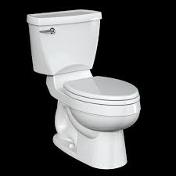
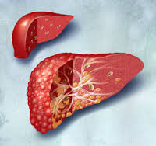
Why … THIS?
Water: YES SSBs: NO
Notes:
Why is this topic so important? Because, as I think you all know, it is healthier to drink plain water instead of soda and other sugar-sweetened beverages, or SSBs for short. And the slide shows some of the reasons.
Plain water as your main thirst quencher benefits your oral health, your cognition and mood, and elimination of toxins from the body.
Cutting back on SSBs also improves oral health, can help you lose weight, and help you avoid metabolic disease like type 2 diabetes and fatty liver disease.
But what if there is poor access to no-charge water in the place where you spend most of the day? It’s difficult if the only appealing water is bottled water that you have to pay for.

Slide 3
Notes:
And just a quick visual about sugary beverages.
Believe it or not, for US teens aged 14-18, a national study shows that soda is the single largest source of calories in their diet. Across all ages 2 and older, sugary drinks are the biggest single source of added sugars in the American diet and are also among the top sources of calories.
Reference:
Reedy, Jill, and Susan M Krebs-Smith. “Dietary sources of energy, solid fats, and added sugars among children and adolescents in the United States.” Journal of the American Dietetic Association vol. 110,10 (2010): 1477-84. doi:10.1016/j.jada.2010.07.010

Slide 4
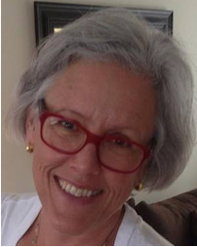
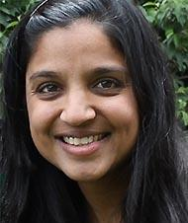
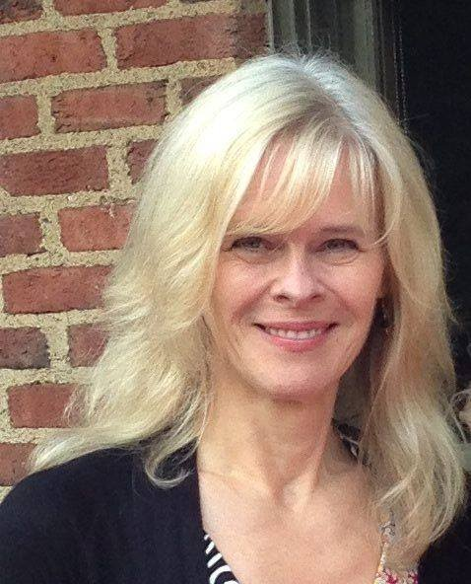
Research Team
Christina Hecht PhD
University of California,
Nutrition Policy Institute
Anisha Patel MD, MSPH, MSHS
University of California, San Francisco
Mary Podrabsky MPH, RD
University of Washington,
Center for Public Health Nutrition
Notes:
How did the photo evidence tool come about? A group of researchers from the University of California and from the University of Washington wanted to find a way to collect as much data as possible about drinking water access, but individually going to schools across the country is expensive and time consuming.
To make a project like this feasible, we imagined enlisting the help of students! We then developed and validated the photo evidence tool as well as ensured that it accurately captures drinking water access information when used by student scientists.
When we performed our research, the students in our study used the tool to contribute to its validation. Now that it has been validated, the students we send the tool to (like you) get to use it for making change!

Slide 5
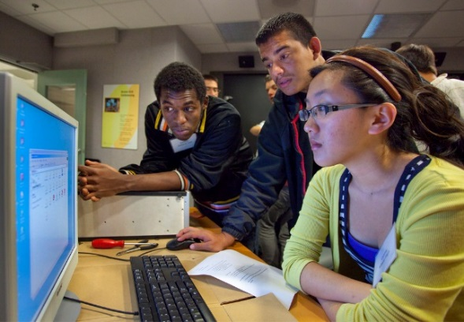
Your Role as Citizen Scientists
Citizen Science: The collection and analysis of data relating to the natural world by members of the general public, typically as part of a collaborative project with professional scientists
As a Citizen Scientist you will:
Follow established protocol exactly to:
Map all water sources in specific schools
Photograph water sources with smartphone or digital camera
Upload photographs and school maps
Notes:
Now let’s talk about your participation in this project. Again, we’re so glad your group is using the tool we developed.
There’s a name for what you are doing – citizen science. Citizen science is when members of the general public use methods to collect data or information in a scientifically valid way.
So, again, you are going to be acting as citizen scientists. It’s our responsibility to teach you how to collect the data accurately. Because of the importance of precision in data collection, it will be your responsibility to follow the data collection protocol precisely.

Slide 6
Long-Term Project Goals
Students can advocate!
Develop better water access
Experience better health
Positive Public Health Impact!!
Notes:
The long term goals of this work center around creating momentum for students to advocate for drinking water access in their schools.
Once you have learned about the protocol and collected the data, you will be using these data to establish the facts about access to drinking water in your school or another setting you may choose to study. With these facts – your evidence-base – you can raise awareness of drinking water access and conditions in schools, then make the case for improvements by helping determine what changes should be made.
Imagine if students and schools across the country did what you are doing! This could lead to a lot more students drinking plain water at school and perhaps a lot fewer diagnoses of things like dental caries or type 2 diabetes.
This project has great potential for positive public health impact!

Slide 7
Why … YOU?
·
Job and college applications
Personal statement
Collect data in the field for research
Poster or oral presentation
Equity and food justice
Health ramifications
HOT TOPIC in epidemiology, public health, oral health, nutrition, in reducing our water, energy and waste footprints on the earth.
Notes:
Now, why do I think this topic is important for you? I’m not sure how each of you will rank these for yourself as an individual, but let me toss out some reasons.
You’ll be able to list your participation in this on job applications and college applications. Your experience, reactions, and insights gained during the project could be great material for a college application personal statement.
You will get to see what it can be like to collect data in the field for research. You might create a poster or oral presentation on this subject matter, on the research project, or on your experience as a participant for a school assignment. There are equity and food justice issues at play around access to safe, free drinking water. There are health ramifications to drinking water access and to factors that impact people’s beverage choices.
And finally, if you are interested in epidemiology, in public health, in oral health, in nutrition, or in the environment, reducing our water, food production, energy and waste footprints on the earth, safe drinking water is a hot topic these days in all these areas.

Slide 8
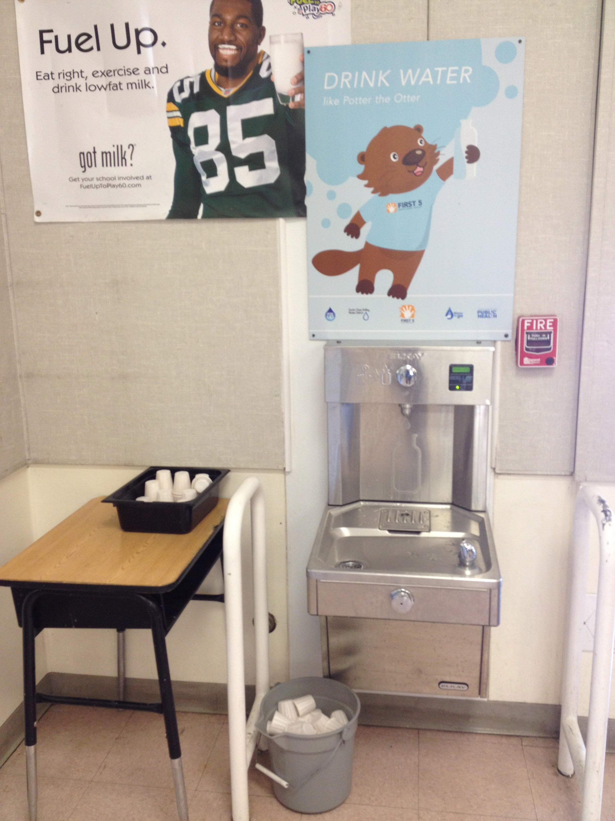
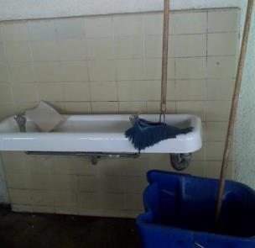
The Photo-Evidence Tool
Documents how drinking water is provided at your site
Notes:
As an overview before we lay out the steps of the protocol, the photo-evidence tool is a series of labelled photos that capture all the elements of how drinking water is provided at your site. It lets you create photographic evidence – a documented record -- of where water sources are, how accessible and appealing they are, and whether your school (or other site) encourages drinking water by, for example, providing cups, or displaying water promotion.
We nicknamed the tool “AQWA” for “Assessing Quality of Water Access.”

Slide 9
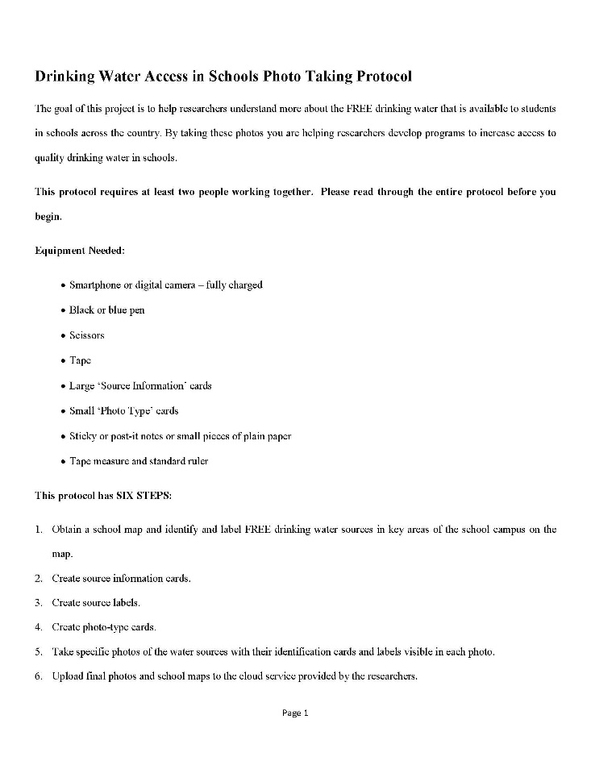
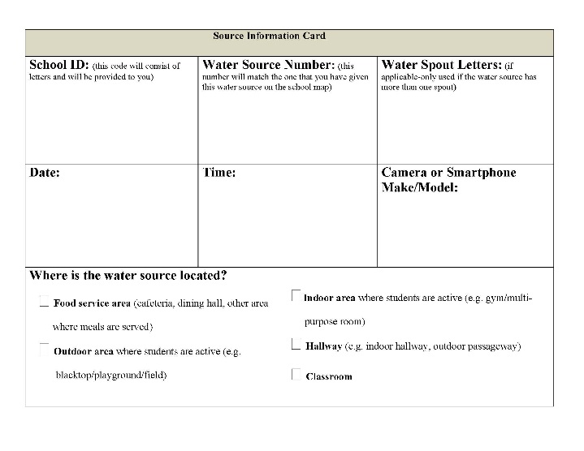
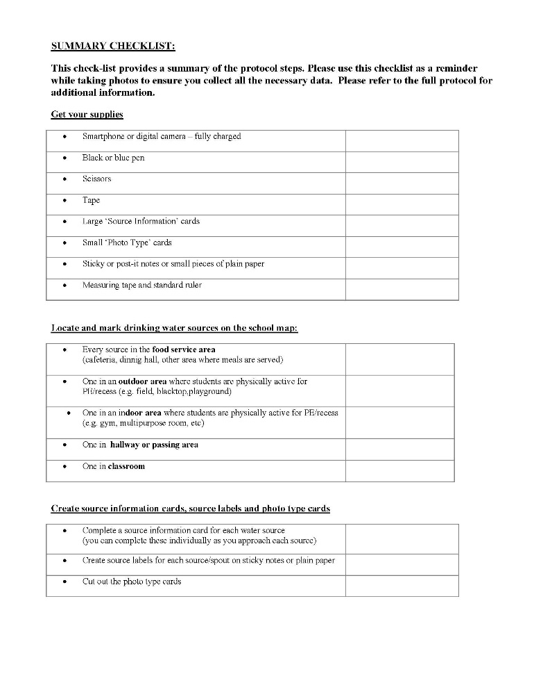
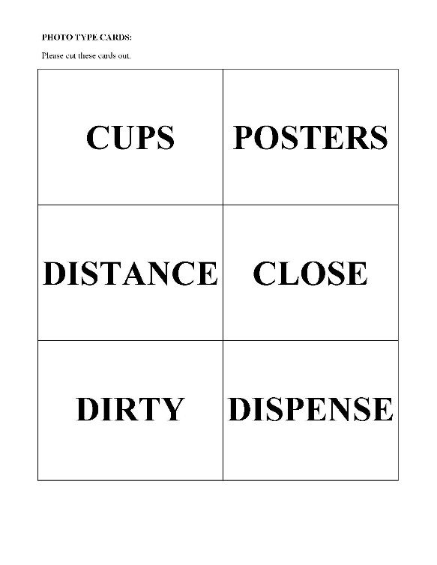
Photo-taking Protocol
Project Documents
Source Information Cards
Protocol
10 Pages
111 pages
Checklist
2 Pages
Photo Type Cards
Notes:
Alright, now let’s move on and walk through this photo-taking process.
Let’s start by taking a look at the four documents that you will be using throughout the project, and they are shown here on this screen. Your teacher or advisor will give these to you ahead of time.
In the upper left corner you can see the protocol, the 10 page document that outlines the specific protocol that you will follow to photograph the water sources in the schools. We’re hoping that you have this in front of you right now so you can follow along in a bit.
We’ve also provided source information cards and these are not really cards, they’re actually sheets of paper that are included in your packet.
Third are photo type cards, and these are printed on a sheet of paper. You’ll be cutting these six different cards out so that you can identify what kinds of photos you are taking, and we’ll be talking about these in a lot more detail in a bit.
Then the fourth document on this screen shows the checklist, and this isn’t anything that you need to turn into us but its something we developed to help you follow along at each school to make sure that you are not missing any steps in the protocol. It will help you keep track of your work.

Slide 10
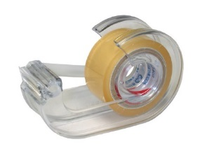
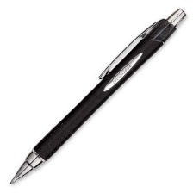
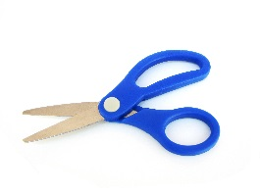
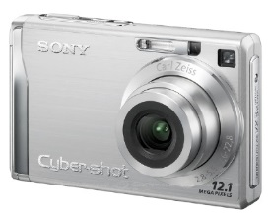
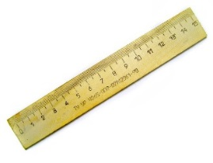
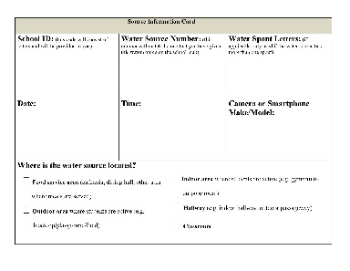
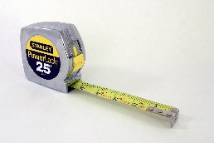
Photo-taking Protocol
2
3
4
1
8
7
6
CUPS
5
DISPENSE
CLOSE
POSTER
DIRTY
Things you will need….protocol pg. 1
Notes:
This slide shows you the different supplies that you’ll need to carry out the project.
You’ll need to have a smart phone or a digital camera that is fully charged before you get started.
You need to have a blue or black pen as well as a red one, you’ll need to have a pair of scissors, you’ll need to have some tape.
You’ll need the large source information card that I talked about briefly, the small photo type cards that you’ll be cutting out, sticky notes like the ones shown here in the photo. These are just little post it notes that have the little sticky part to them. If you don’t have sticky notes, little pieces of plain paper and tape will work just fine. And then we also would like you to have both a tape measure and a standard ruler.
Your teacher or advisor will help you gather these things up.

Slide 11
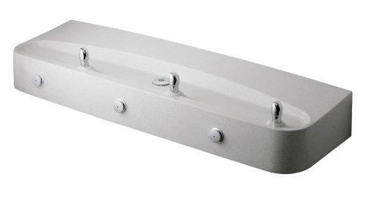
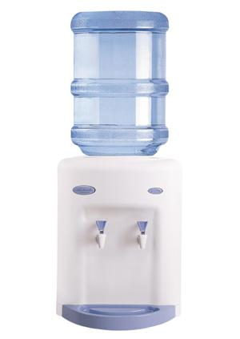
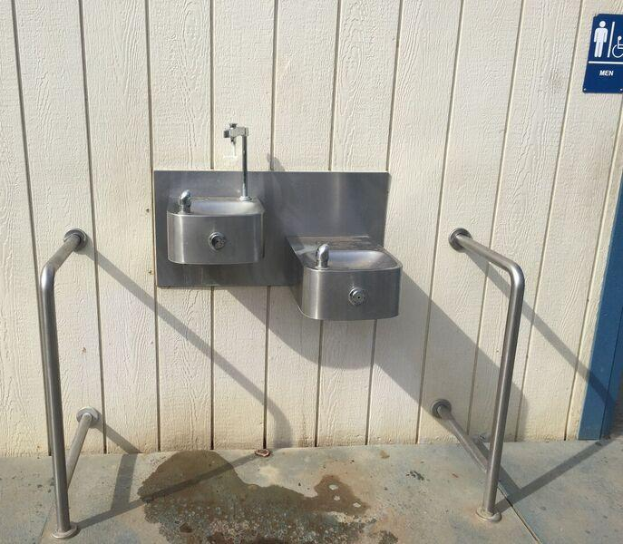
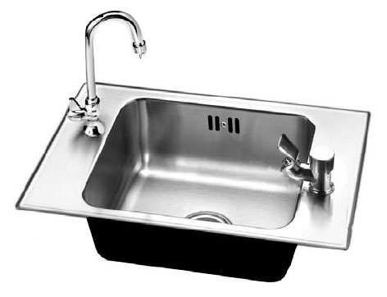
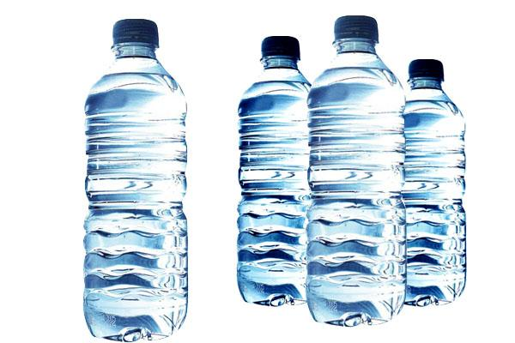
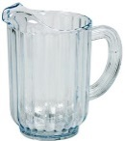
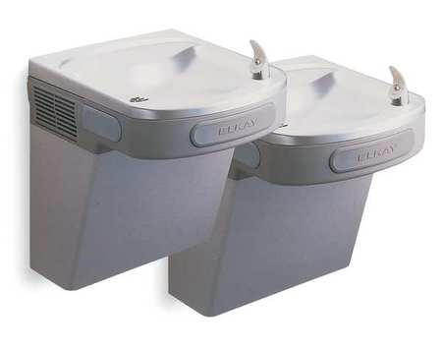
What is a “water source?”
Notes:
We’re going to be talking a lot about water sources when we review the steps in the protocol, and we wanted to take a minute to define exactly what we mean when we talk about water sources.
First of all, we are only interested in water that is offered in the schools that is free to students. If drinking water is sold in vending machines, you may also choose to take photos that document the availability and price of bottled beverages.
This slide gives you examples of the kinds of water sources that you might be seeing in the different schools that you are going to be visiting. There is one of these really nifty combination water fountain and water bottle fillers up in the left corner, I don’t know if all of you have seen these or not but they are wonderful they have actually two places on the fixture where water is dispensed and just going around the slide a little bit, there are all kinds of varieties of fountains that have multiple spouts or in the lower left the single spout variety that you are probably most familiar with. In some of the classrooms you are likely to see sinks that have one fixture attached to them specifically for drinking. There are pitchers, there are five gallon jug coolers, a variety of things.
You may or may not see all of these in the schools and you also may see some things that are not identified here on this slide, but this will hopefully give you an idea of the kinds of water sources that we are looking for.

Slide 12
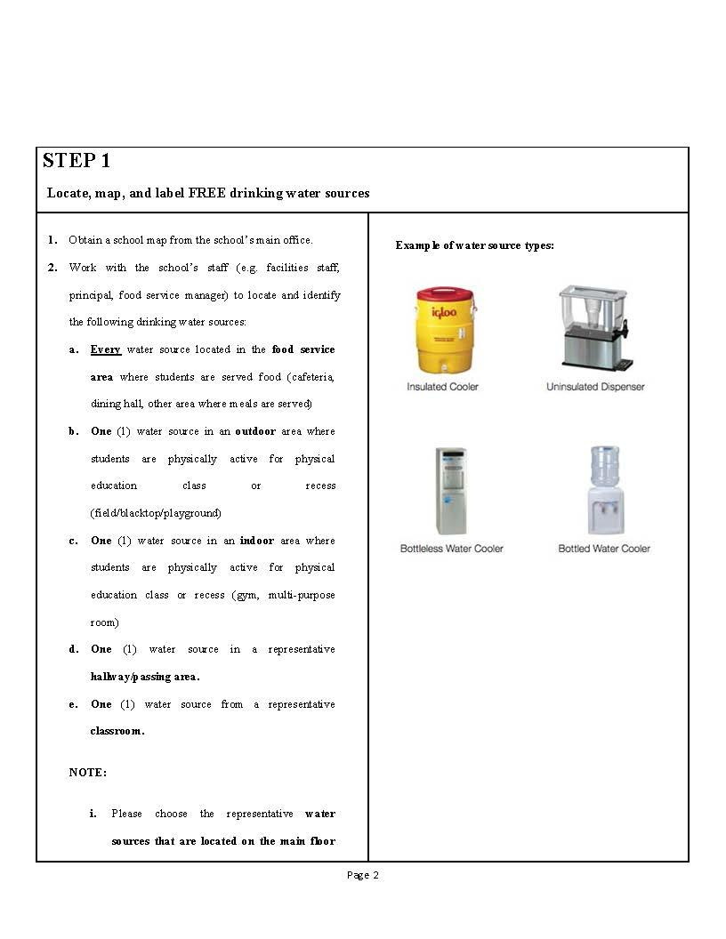
Step #1: Map and Label Water Sources
Go to Protocol
Page 2
Notes:
Let’s start going through the steps. You should follow along on your 10 page protocol document and we’re going to start with step 1, which is on the second page of the protocol, and this is where you are going to be mapping and labeling the different water sources that you will eventually be photographing.

Slide 13
Step #1: Map and Label Water Sources
Obtain floor plan of school
Identify and mark with a “ ”
Foodservice/cafeteria area where students are served food
E.g. cafeteria, dining hall, etc. where meals are served
Outdoor area where students are physically active for PE/recess
E.g. field, blacktop, playground
Indoor area where students are physically active for PE/recess
E.g. gym, multi-purpose room, etc.
Hallway or passing area
Classroom
Don’t count water sources not typically used for drinking (hand-washing sinks, science laboratory sinks)
Notes:
The first thing that you will need to do is get a floor plan of the school. In our research, we’ve found that these are usually available at the front desk so if you just ask the administrator or the students who are working the front desk for the floor plan of the school, they ought to be able to get one for you.
The list on this slide details the water sources photographed in our initial research study, but it is not required that this list be adhered to strictly. It is just meant to give you ideas about the types of water sources your group might be interested in for this project. It will be up to the discretion of you and/or your advisor to determine your own list of what to include.
For example, you may plan only to include the water sources required by the Child Nutrition Act in the places where meals are served. Or you may be planning to include every drinking water source on campus – or some agreed-upon sample or sub-set of all of these. Whatever you are photographing, make sure you are all in agreement about how you’ve defined them, and then make sure each is correctly mapped and labeled for future reference.
It’,s really important that in addition to any fixed water fountain or water sources that are in the cafeteria area, you are also capturing anything that is put out specifically during meal service in the way of free drinking water. For example, if food service staff put out pitchers of water, or they put out bottled water on the counter, we want you to be able to photograph and document those items as well. SO you’ll need to check with the food service staff or some other knowledgeable person in the school to find out if indeed they are putting additional water out during meal time for breakfast and lunch and if they are, on the map, put a mark for each pitcher that they tell you is typically put out and then also a dot for any collection of water bottles that would be put out for students to choose.
We want to make sure that you are choosing water sources that are used for drinking so for example if you go into an arts and crafts room and there is a sink there that’s clearly just used for the activities of the class but nobody is drinking from it, that wouldn’t be one that you would choose to photograph.

Slide 14
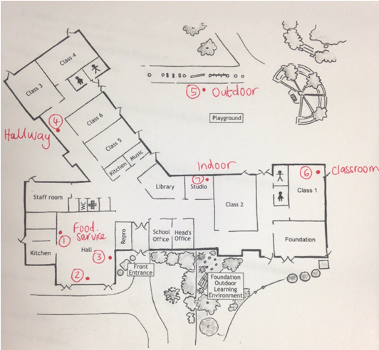
Numbering Water Sources on Map
Water Source – the entire water source (fountain, bottle filler, pitcher, bottled water offering) regardless of the number of spouts
#1
Consecutively Number each water source on the map
#2
Notes:
The next step is to assign numbers on the map to each water source. So you’ve got this great map in front of you that has all these dots all over it, and now we want you to give each one of them a unique number. Just go around your map and write consecutive numbers by each water source, and in this step, again, each water source only gets one overall number, regardless of how many spouts are on it.

Slide 15
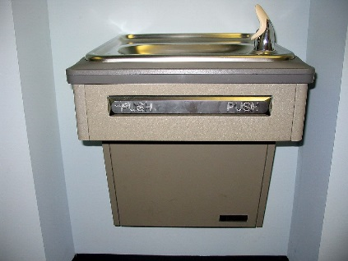
Labeling Water Spouts
Water Spout – any place on the Water Source where water is dispensed
#1A
IF there is more than one spout, use letters to label each water spout on each water source
#1
#1B
You won’t need water spout letters if there is only one spout. Like this fountain
Notes:
Now the next step is where you assign a unique letter for each spout. For those water sources that do indeed have two or more places on the fixture where water is dispensed, you’re going to assign a letter, starting with “A”. There might also be a pair of water fountains together at that water source location, and you would also assign different letters to the separate spouts on those as well.
So the two fountains together are one water source but their spouts will have different letters. It’s not very likely that you’re going to have one that has more than two spouts - you might - but still assign consecutive letters to the spouts and write those right on your map. Now if a water source only has one spout, like the one in the lower right hand corner, you’re not going to need to assign any letters at all, you can completely skip this step for any given fountain that only has one spout.
I also wanted to take a moment here to emphasize the importance of labeling the map accurately as well. The codes on the source information cards and the sticky notes that you will make next identify which water source is being photographed and where it is located. The photos themselves and photo type cards indicate what the conditions of that water source are. Rather than guessing where the fixtures are later on, based on backgrounds in the photos, it is better to be absolutely sure by having a map clearly labeled with each water source. This way, the source information cards and sticky notes in the photos can be matched with the map. For example, knowing that outdoor water sources or classroom water sources are consistently broken or dirty is very useful information! This also means that the map needs to be legible when it is uploaded. Please write neatly and large enough!

Slide 16
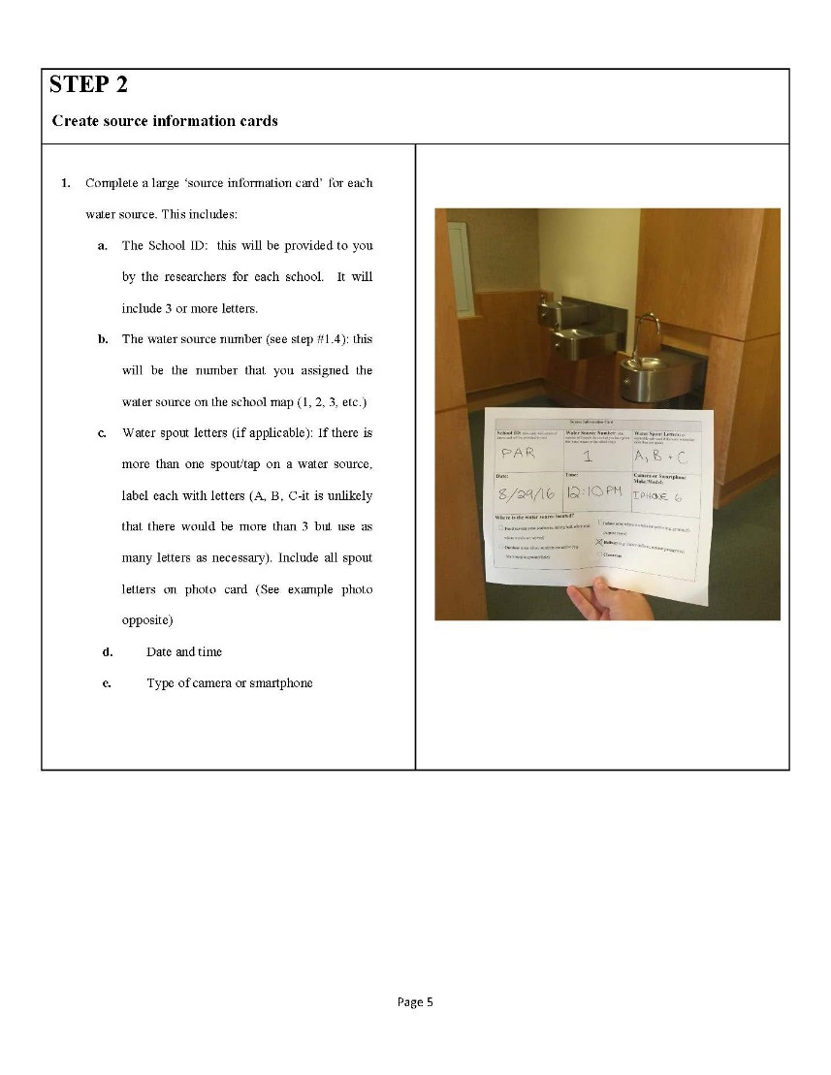
Step #2: Create Source Information Cards
Go to Protocol
Page 4
Notes:
Steps 2, 3 and 4 are all about creating labels for your photos so that each picture is correctly identified for later use. So first let’s look at step 2. You’ll find it on on page 4 of your protocol and this is where you’re creating what we call source information cards.

Slide 17
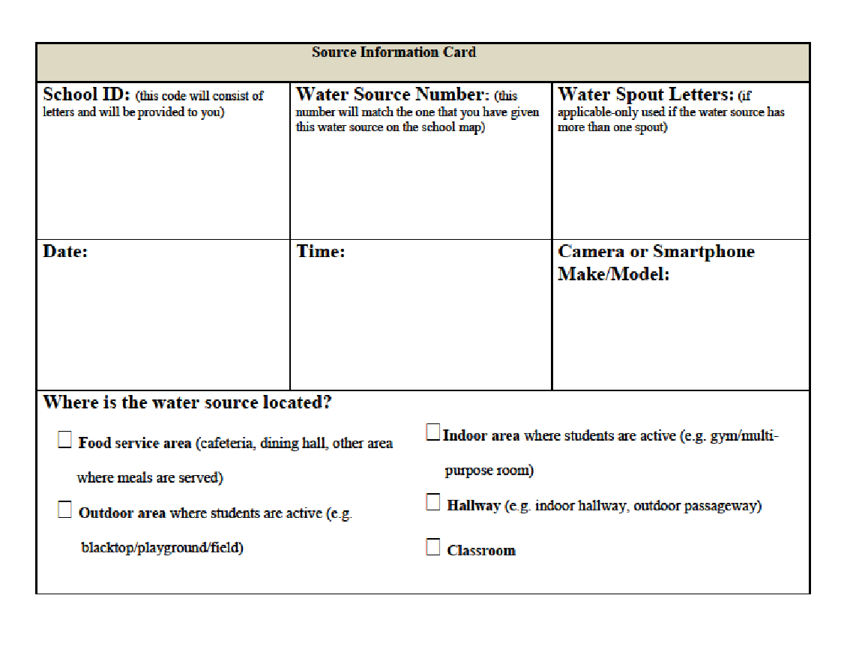
Step #2: Create Source Information Cards
Notes:
And this is what a source information card looks like. You will create one of these for every single water source that you photograph and it will serve as a kind of cover sheet for the rest of the photos you will take of that water source. Let’s take a look at all of the things that are on this card.
Starting in the upper left hand corner, you’ve got a school ID, this is a code that your advisors are going to provide to you and will most likely be a three letter code that has some of the letters of the name of this particular school on it. They will give that to you and you’ll put that school ID on every source information card for each water fixture or water source that you’re going to be photographing in that school.
Next to the school ID, is the water source number, and this is that number that you’ve assigned that water source on the map that you just created.
In the same box as the spout letter, also include on what floor of the building the source is located as well as a general description of where this is located. An example of this would be something like “2nd floor, end of hallway near restrooms.” Then comes the water spout letters, if that particular source has more than one spout.
Looking at the bottom row, you write the date, and record the time that you started photographing this water source.
In the last box, record the camera or smartphone make and model you used to take the photograph, and you don’t have to get real fancy or real detailed here, simply record if it’s an iPhone, or what kind of smart phone it is or what kind of a digital camera it is. Is it a Canon? That kind of a thing is all you need to put there.
And then on the bottom of the form, you’ll simply put a check mark in the area where the water source is located.

Slide 18
Example of Completed Source Information Card
Notes:
Here’s a quick look at what a completed card looks like with all the different parts filled in. You can see on this card for this water source, there are three different spouts, and in the upper right hand corner of the information card you’ve got the letters A, B and C.

Slide 19
Complete one Source Information Card for each water source.
Remember, many types of water sources
Notes:
And once again you will be creating one of these cards for each different water source that you photograph.

Slide 20
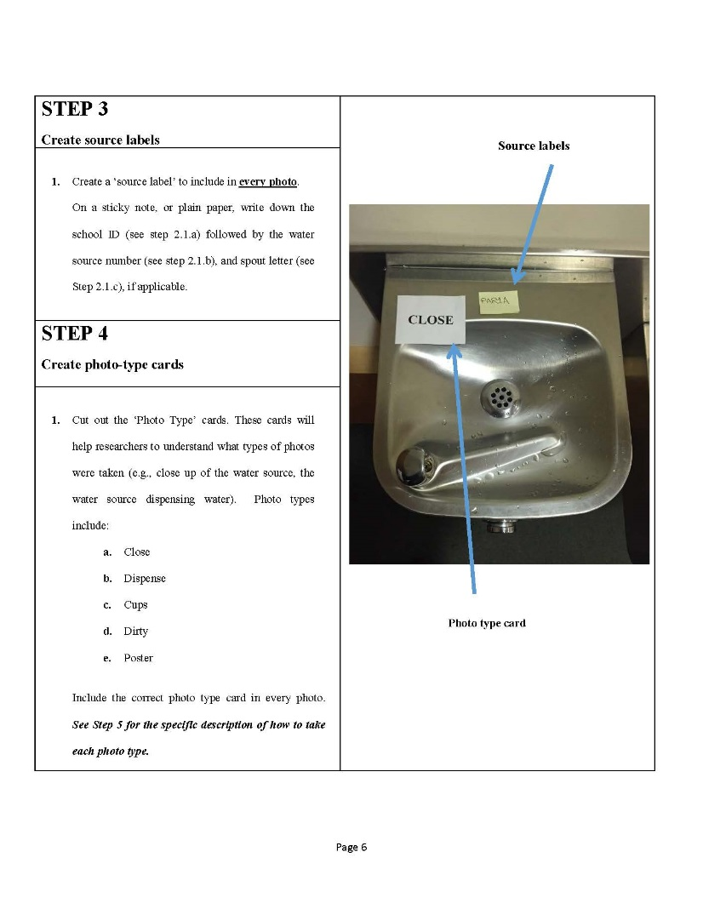
Step #3: Create Source ID Labels
Go to Protocol
Page 5
Notes:
Moving on to step number 3, this is where you’re creating source labels, and you can follow along here on protocol page 5. Now, this is the step where you will need those sticky notes – the post it notes or the plain pieces of paper and tape to make these source labels.

Slide 21
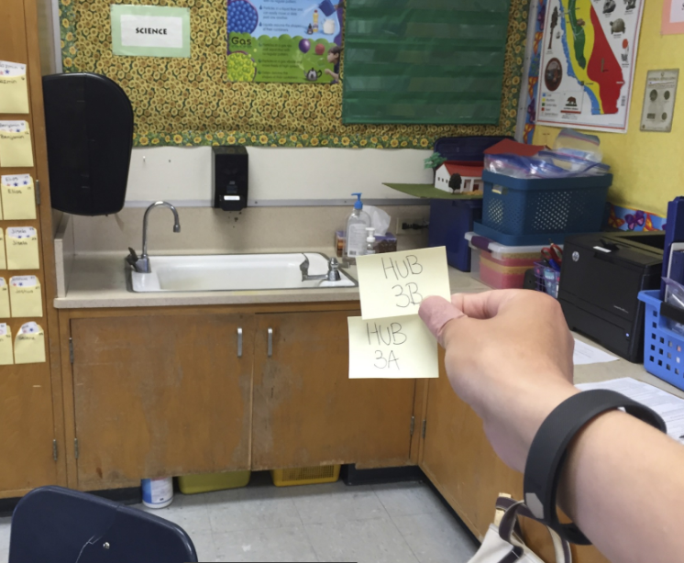
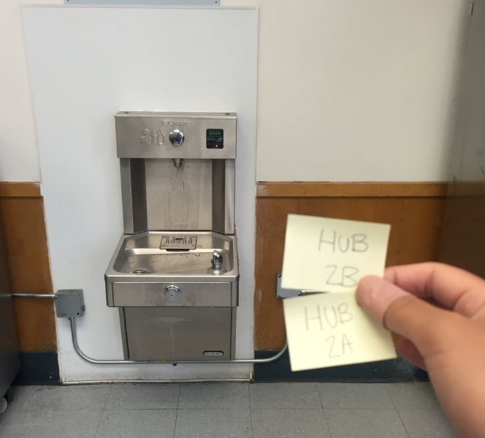
Step #3: Create Source ID Labels
Create one for EVERY spout – use in every photo (except for the one with the large Source Information card in it)
Label with School ID; water source number, and spout letter (if there is one)
Notes:
You’re going to create one of these for each spout, and you’ll use it in every photo you take of that spout.
Each sticky note will include again that school ID which is the three letters that will be provided to you that identify the school that you’re in, the water source number, again that’s the number on the map that you gave that water source, and then the spout letter if there is one.
The information on these source labels should correspond with the information on the top half of your source information card.
And you can see for example in the big photo in the middle of this slide, the photographed fountain is actually the sink with the two spouts and so they’ve got the HUB which is the school ID, 3 which is the number on the map that was assigned to that sink area, and then spout a and spout b.

Slide 22
Step #4: Create Photo-Type Cards
Go to Protocol
Page 5
Notes:
And now we’re going to be creating photo type cards. This is also on page 5 of your protocol.

Slide 23
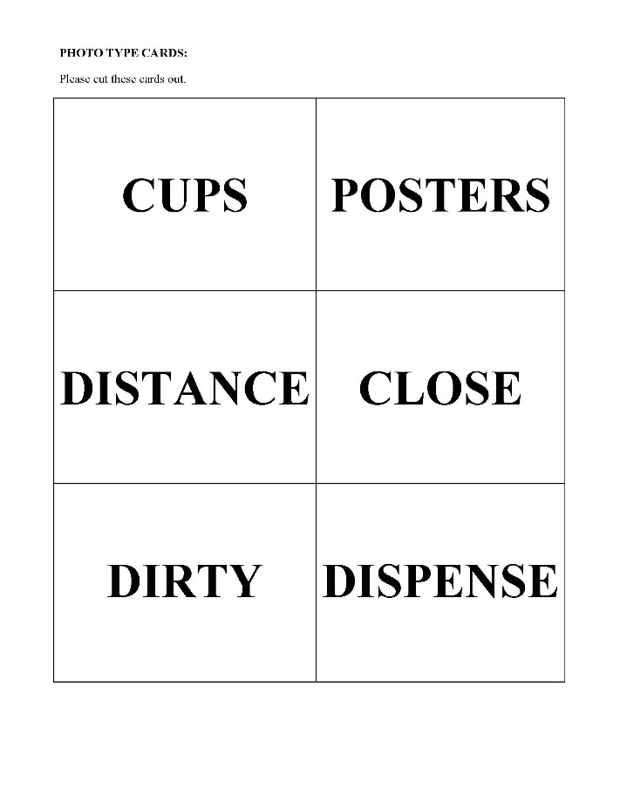
Step #4: Create Photo-Type Cards
Cut out the 6 photo cards from sheet.
You will include one photo type card in each photo (except for the the one with the large Source Information card in it)
✁
Notes:
And what you’ll be doing here is simply cutting out the six photo cards from the sheet of paper that was provided with these already printed on it.
Or instead of printing them out and cutting them, you can also make your own using your little sticky notes or slips of paper if that is easier.
The purpose of these is to identify the type of photo that you are taking, and we’ll be talking about that in a little bit more detail in a bit.
These cards basically identify what you are focusing on when you are taking this particular photo. You are going to be including one of these in every single photo that you take, except the very first photo that we’ll talk about.

Slide 24
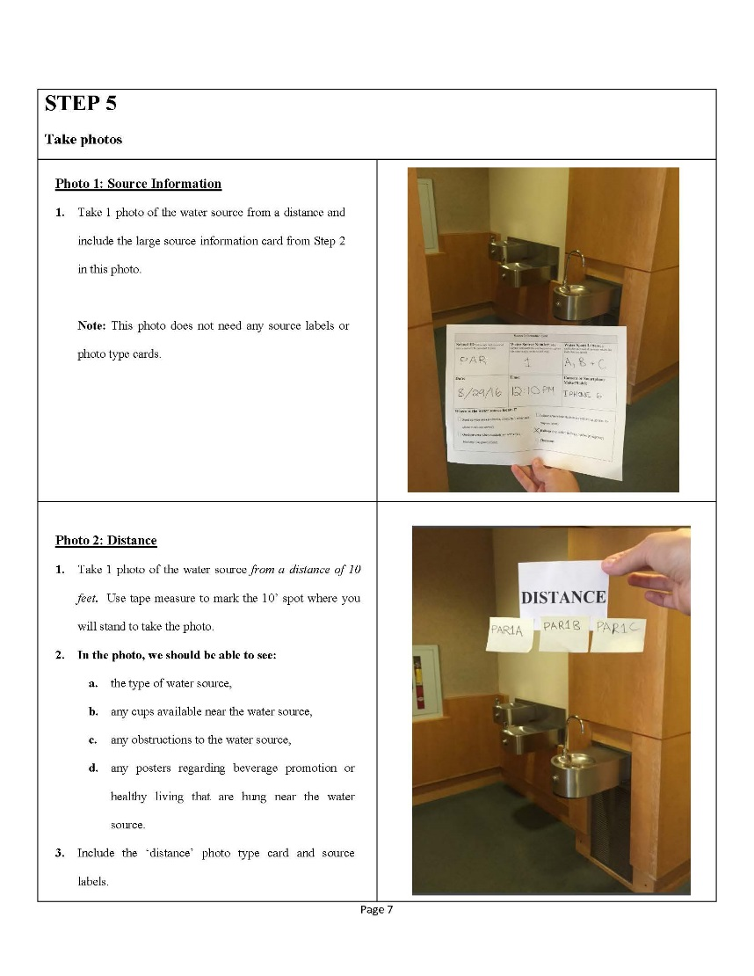
Step #5: Take Photographs
Go to Protocol
Page 6
Notes:
Alright! Now we are getting to the fun part where we’re actually going to start taking the photographs.
If you jump to page 6 on your protocol, you can follow along. There are 7 types of photos and hopefully by now you have seen the little video clip of Sasha and Sophie taking all of these different types of photos so you have an idea of what the process actually is going to look like.
As you’re taking the pictures, please check the quality of each photo before proceeding to the next one. If it’s a little blurry or you can’t actually see what is going on in the photo at that water source, and this includes the visibility of the labels and cards that should be in view as well, so if something is not quite clear enough, go ahead and re-take photos as necessary to get a clearer, more visible one.

Slide 25
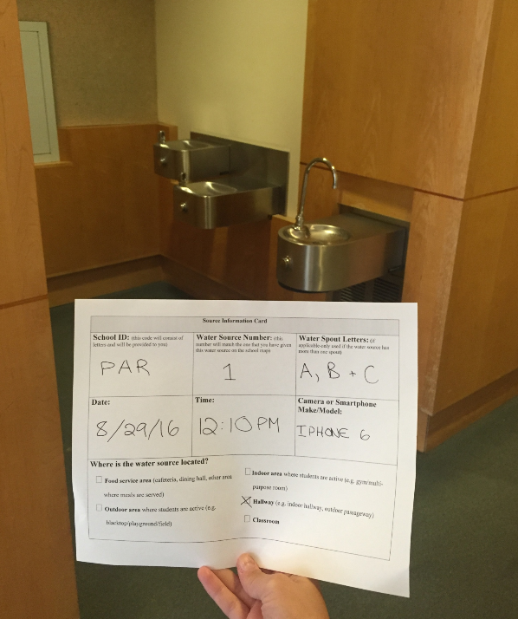
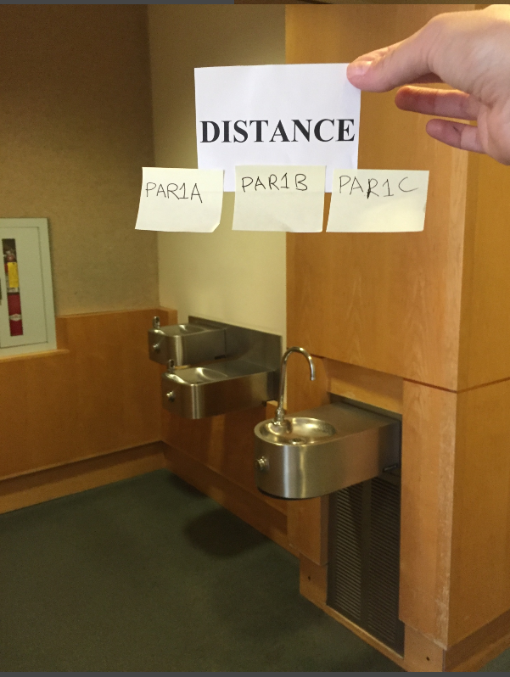
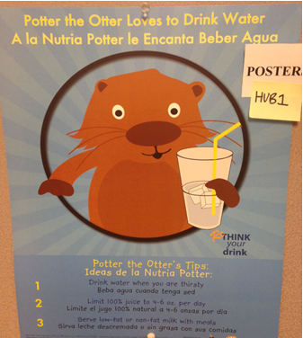
Step #5: Take Photographs – 7 types
1. Source Information: taken from a distance-include Source Information Card (no source labels or photo type cards needed)
For all remaining photos, you will include a Source Label and a Photo-type card in every photo
2. Distance: taken from 10 feet away – shows type of water source, any cups nearby, any obstructions like garbage cans or mop buckets, any water promotional materials
3. Poster: capture any water promotional materials (like posters) near water source –TAKE 1 CLOSE UP OF EACH
Notes:
Even though there are 7 types of photos, you will not always be taking all 7 photos for each water station.
It will really depend on what’s going on with the water source, and that will become a little bit more clear as we go through the different types of photos.
The first photo that you’re going to take is called a source information photo and you will always take one of these for every single water source. To do this you just step back from the water source and take a photo that shows both the water source and that big source information card that you created earlier on, and you can see an example of that photo here on the slide.
Next you will always take one called a distance photo. What you’ll do here is use the tape measure to mark off ten feet from the water source. Be sure in this photo that you include the surrounding area so we get a really good idea of what is happening in the environment of that water source. Are there posters? Is there a garbage can? Are there cups? What other kinds of things are surrounding that particular water station?
The next type of photo is what we are calling a poster photo. Now, the purpose of these is to show any kinds of promotional material or posters around the station that are encouraging students to drink water or talking about water in any kind of way. Now these could be posters, there might be a bulletin board nearby, there may be little signage around, but we want you to take a close up of each promotional poster or sign. Again, being sure to include the source label and the photo type card in each photo.
If there are no promotional materials, you won’t be taking any of these photos.

Slide 26
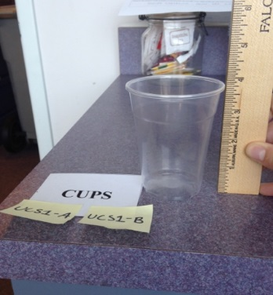
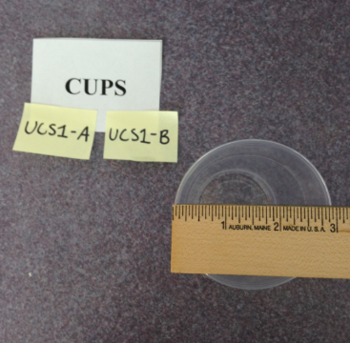
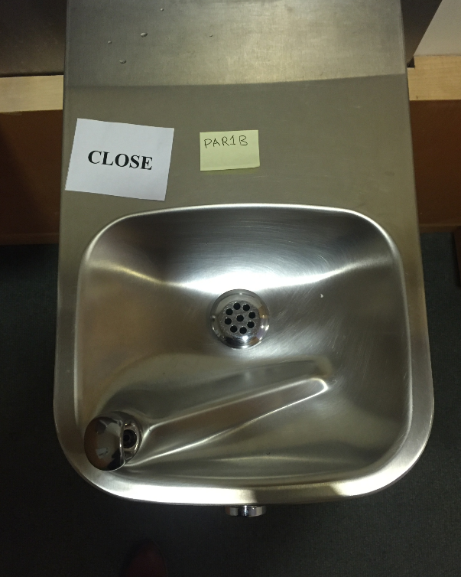
Step #5: Take Photographs – 7 types
4. Cups: capture any cups near the water source – use ruler to show height and width – TAKE 2 PHOTOS-ONE SHOWING HEIGHT, ONE SHOWING WIDTH
5. Close: taken from 18 inches away – shows if water basin/water spout is clean or dirty: -Take at least 1 that clearly shows if basin/spout is clean or dirty
-Take one photo for each spout
Notes:
The next kind of photo to take is called a “cups” photo. Here you to capture any cups that are near the water source. We want to see the size of the cup so you will take two photos. One of the photos will be taken with the ruler you have standing upright by the cup, as shown here in that first photo. And the second will be taken with the ruler across the top of the cup so that we can see the width of the cup. Make sure the edge of the ruler matches up with the edge of the cup so that the measurement starts from zero.
If there are no cups you of course won’t be taking any of these photos. If you know this source normally provides cups but they are ”out” that day, take a photo of the empty cup dispenser.
The next kind of photo that you will take is what we are calling a “close” photo, and you will always take one of these for each water source. Use the tape measure to measure about 18 inches away from the water source. The purpose of this photo is to show the general condition of the fountain. In other words, whether the basin and each spout are clean or dirty. If there are multiple spouts, take photos of each one of the spouts. Again, include the source label and photo type card in each photo as shown here. Just a reminder here, especially with these close up photos of the cups and the spout that you just took, and the other close ups that you will be taking next, be sure to check that the photos are clear and we can see what’s in the picture before you move on to the next one.

Slide 27
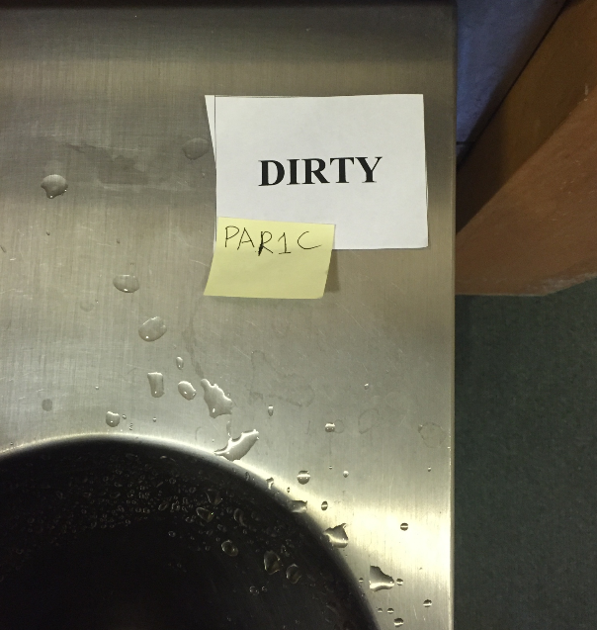
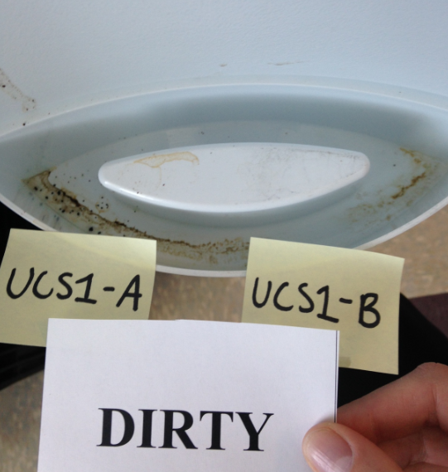
Step #5: Take Photographs – 7 types
6. Dirty: Take photos for each spout to show any unclean characteristics of water source (leaves, sticks, dirt, sand, hair, food, gum, spit, mold, rust, clogged/stagnant water, insects, etc.) If water source is clean, you won’t need this photo.
Notes:
The next type of photo is what we’re labeling as “dirty.” In this photo, you are focusing on unclean characteristics of the water source. These could include leaves or gum, hair or rust. Anything in the water source that is unappealing.
Take as many photos as you need to really capture these unpleasant characteristics of the fountain. Be sure again to include the photo type card and the source label in each photo.
If you’re photographing a water source that looks clean, it looks pretty darn good, you don’t need to take these particular photos.

Slide 28
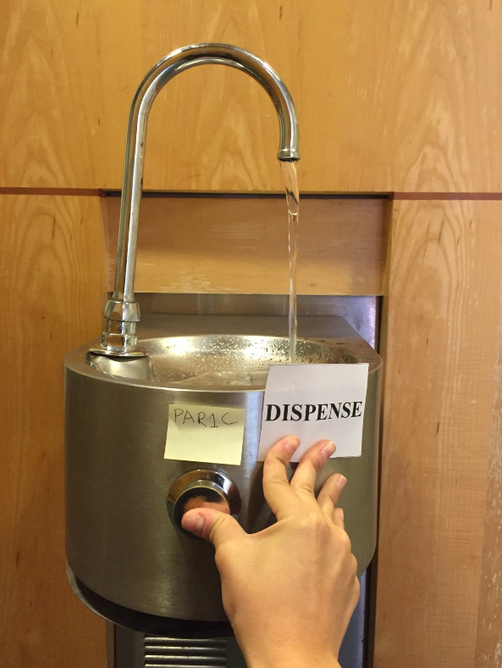
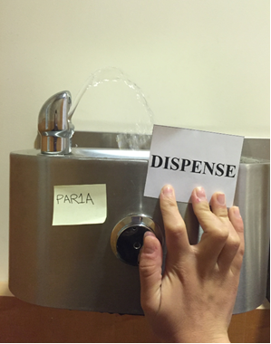
Step #5: Take Photographs – 7 types
7. Dispense: completely press or turn knob to dispense water. Shows how strong flow is (fountains); erratic flow
If the water flow is erratic (fluctuating between high, satisfactory, and low within a few seconds): TAKE SEVERAL PHOTOS THAT DEMONSTRATE THE DIFFERENT LEVELS OF WATER ARCH OR STREAM
If the water source is broken, or the jug of bottled water is empty, and there is no water dispensing, take a photo of yourself pressing/pulling the button/lever to demonstrate that there is no flow. Always take a ‘dispense’ photo, otherwise the it might be assumed that you have forgotten to take this photo.
For bottled water or a pitcher, take a photo that reveals how full or empty the container is.
Notes:
Finally, always take a photo that we are calling the “dispense” photo. The purpose of these photos is to show how well the water flow is working at a particular water station.
You’ve all seen water fountains where you push the button or turn the knob and you practically have to put your mouth on the spout to get any water. We want to capture that kind of thing, but we also want to capture good things that are happening with fountains as well. So the first thing that you will do is completely press or turn the knob to dispense the water. Now, if the water flow is erratic, we’d like you to take several photos that show the different things that are going on with the water arch or the stream. Try to get a picture when the water flow is high and when it is low. But if the stream is good and strong, and it is not erratic, one photo is going to be just fine.
If the water source is broken or empty, and we’ve all seen those too, and what we mean by this is there is no water that is dispensing or it’s a container, for example a bottle cooler, that has no water in it, take a picture of your hand pressing the button, pulling the lever, or turning the knob, so you can demonstrate to us in the photo that there is no flow.
One team member can “dispense” water while another person captures the flow. You will need to assess the best way to do this. And again, being sure to include the source label and photo type card in each photo.
If you happen to be photographing a pitcher or a jug of bottled water, just take a photo showing how full or empty the container is. In the case of individual bottled water or a pitcher, you do not need to take an actual “dispense” photo of someone pouring out water! You just want to document whether this water source is actually usable.

Slide 29
Re-cap: Some photos are required for each water source:
Source ID card photo
Distance
Close
Dispense
Every water source will have at least 4 photos.
Cups
Posters
Dirty
Others are taken as needed:
Notes:
As we mentioned before, even though there are 7 types of photos, you might not be taking all 7 for every single water source.
The first four listed here are the photos that are required for every single water source.
The three listed on the bottom of the slide are the types of photos that only need to be taken if the conditions corresponding to them are met. So that means IF there are cups present near the water source, IF there are posters present near the water source, or IF the water source is unclean, then and only then do those types of photos need to be taken to show that.

Slide 30
Re-cap: When there is more than one spout, take the following photos for each of them:
Close
Dispense
Dirty
These are individualized to each spout!
Source Information, Distance, Poster, and Cup photos only need to be taken once!
Notes:
It is also important to make a clear distinction between the kinds of photos that need to be taken multiple times in the situation of multiples spouts for each source. When there is more than one spout, the close, dispense, and dirty photos need to be taken for each spout. This is because these are the photos that depict characteristics specific to each individual spout. The other photos (source information, distance, cup, and poster photos) will capture those characteristics for all of the spouts from that water source at once.

Slide 31
IMPORTANT!
Photos must be limited to water sources and immediate surroundings
Under no circumstances are students, teachers or other staff to be photographed
If students are close to water sources, such as pitchers or water fountains, wait until the area is clear before taking photographs
Notes:
And those are the steps! It may seem like a lot but we think that once you have a few of these under your belt you will find it pretty easy. Be sure to practice before you set out to take your final photos.
There are a couple more really important reminders that we want to provide to you.
We want you to be sure that you are limiting photos to the water sources and their immediate surroundings. Focus on the water sources and the immediate area. Under no circumstances are students, or teachers, or other staff to be photographed. Besides yourself of course, since we’ll be seeing your fingers and hands in some of these photos, but other people should not be photographed at all in any of the photos. If students are close to the water sources that you are trying to photograph, such as pitchers or water fountains, just wait until the area clears before you start taking your photographs.

Slide 32
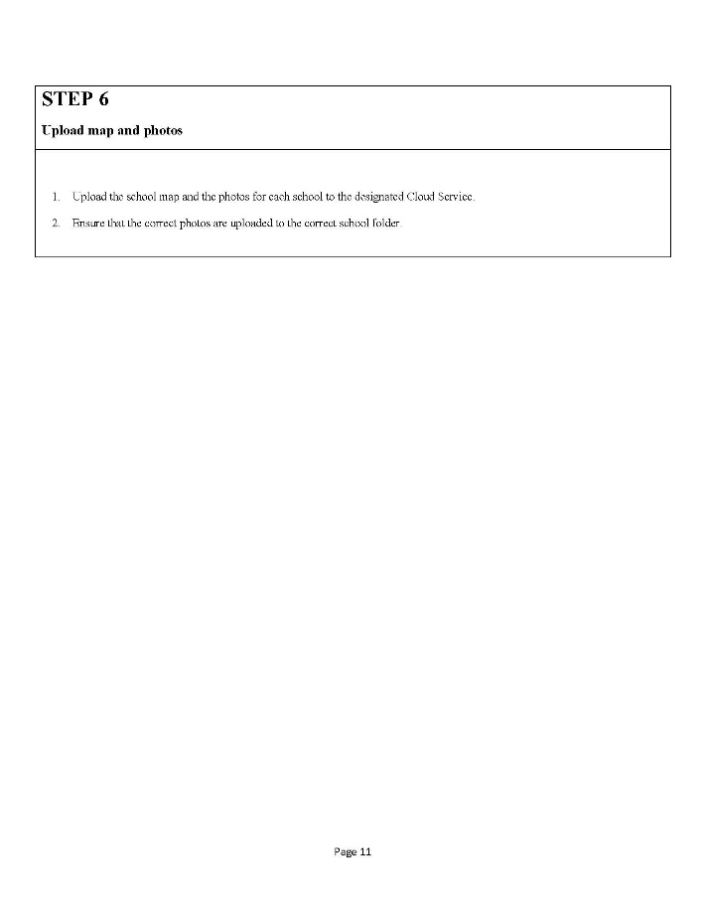
Step #6: Upload Map and Photos
Go to Protocol
Page 10
Notes:
Now for the final step: uploading the map and the photos to the shared drive your advisor has set up for this purpose. Go to page 10 on your protocol.

Slide 33
Step #6: Upload Map and Photos
Example image/file name: CUH_1_AB_distance.
Instructions to accessing a shared drive will be provided by your project leader.
The project leader will have a folder for each school with the school name and school ID. Upload map and photos there.
Notes:
Before you upload your photos, it is important to take the time to name the file/image according to the type of picture it is.
Look at the example label on the screen. Start with the school code, followed by the water source number, spout letter and type of picture with underscores in between each of those descriptors. This will make it easy to organize and identify the images for later use.
When you are actually uploading your photos, there should be folders in your shared drive pertaining to each school, which might be found within the folders for each district, if applicable to your group’s work. What you will do when you go to the shared drive is you will find the school that you have taken photos in, and their folder should be labeled with the name of the school followed by a dash and the school’s code that has gone on your source information cards.

Slide 34
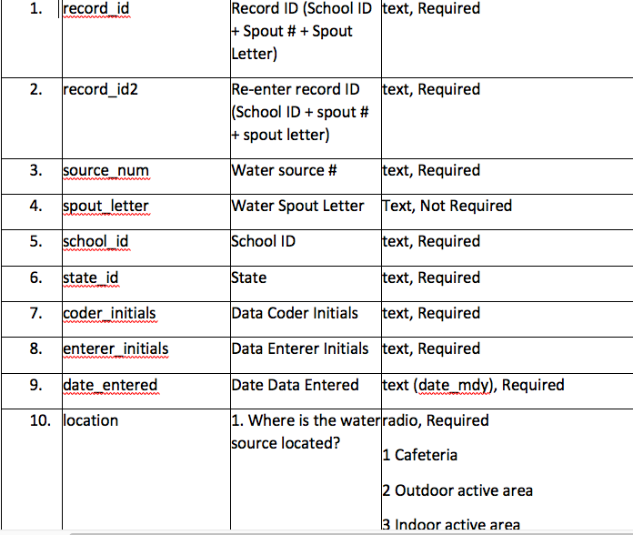
Interpreting and reporting your data
Next steps
Score photos – using Google Form
Summarize data – using Excel Document
Report results
Notes:
Once all of the photos are collected and stored in a shared drive, they can be accessed easily to fill in the AQWA Scoring Data Entry Form (Google Form) at the link we provided you with. This is so you can extract meaningful information from the photos your group took. After they are scored, the Summary Table in the AQWA Scoring Formula Workbook (Excel Document) will help you summarize the data and translate them into useful statistics to aide in your report generating.

Slide 35
That’s it!
We’d like to hear from you
How did it work?
What did you learn?
What was your project goal?
What did you do with your learnings?
Email
DWAlliance@ucanr.edu
Thank you!
Notes:
And that’s it! If there are any questions, here’s an email address you can write to for help or feedback on the process. We’d like to know if anything went poorly, but we also would like to know what went well.
National Drinking Water Alliance researchers and advocates would like to learn about your study and your findings: what your project goals were and what happened as a result of your work!
Thank you once again for working on this important project. We think that you’re going to find it very educational and interesting, and we’re also hoping that you’ll have a little fun along the way. You are certainly helping researchers and policy makers understand what’s happening in the world of water in schools or other community settings.
Good luck and thank you again for working with us on this important project.

Slide 36
The Photo-evidence tool was developed by University of California - Nutrition Policy Institute University of California – San Francisco University of Washington – Center for Public Health Nutrition With assistance from America’s ToothFairy: National Children’s Oral Health Foundation Funded by The Robert Wood Johnson Foundation Healthy Eating Research

